Slide 1



Statistical Analysis and Learning (SAL): (ISL Resampling Methods, Ch5) Textbook: An Introduction to Statistical Learning (ISL)
Varun Rai
LBJ School of Public Affairs
The University of Texas at Austin
28th February 2018

Slide 2
Note on Material
Unless otherwise noted, all material in this presentation are from this course’s textbook, An Introduction to Statistical Learning (ISL)

Slide 3
Resampling Methods
Resampling methods are an indispensable tool in modern statistics.
They involve repeatedly drawing samples from a training set and refitting a model of interest on each sample in order to obtain additional information about the fitted model.
For example, in order to estimate the variability of a linear regression fit, we can repeatedly draw different samples from the training data, fit a linear regression to each new sample, and then examine the extent to which the resulting fits differ.
Such an approach may allow us to obtain information that would not be available from fitting the model only once using the original training sample.
Notes:
Begin session 1

Slide 4
Resampling Methods
We discuss two of the most commonly used resampling methods, cross-validation and the bootstrap .
Cross-validation can be used to estimate the test error associated with a given statistical learning method in order to evaluate its performance, or to select the appropriate level of flexibility.
The process of evaluating a model’s performance is known as model assessment , whereas model the process of selecting the proper level of flexibility for a model is known as assessment model selection.
The bootstrap is used in several contexts, most commonly model to provide a measure of accuracy of a parameter estimate or of a given selection statistical learning method.

Slide 5
The Bootstrap
Notes:
Begin session 3

Slide 6
Bootstrap
The bootstrap is a widely applicable and extremely powerful statistical tool that can be used to quantify the uncertainty associated with a given estimator or statistical learning method.
Generally, the bootstrap is used for estimating standard errors and bias, obtaining confidence intervals, and sometimes for tests.
As a simple example, the bootstrap can be used to estimate the standard errors of the coefficients from a linear regression fit.
In the specific case of linear regression, this is not particularly useful, since standard statistical software such as R outputs such standard errors automatically.
However, the power of the bootstrap lies in the fact that it can be easily applied to a wide range of statistical learning methods, including some for which a measure of variability is otherwise difficult to obtain and is not automatically output by statistical software.

Slide 7
Bootstrap

Slide 8
Sampling Distribution: From the Population
Notes:
“The primary task of a statistician is to summarize a sample based study and generalize the finding to the parent population in a scientific manner.” (Singh and Xie)
Let us suppose, information is sought about a population parameter x. Suppose x_bar is a sample estimator of x based on a random sample of size n , i.e. x_bar is a function of the data (X1, X2,..., Xn) . How to estimate standard error of x_bar , as the sample varies over the class of all possible samples?

Slide 9
Bootstrap Distribution: From the Sample
The sample serves as an ‘estimate’
of the population!

Slide 10
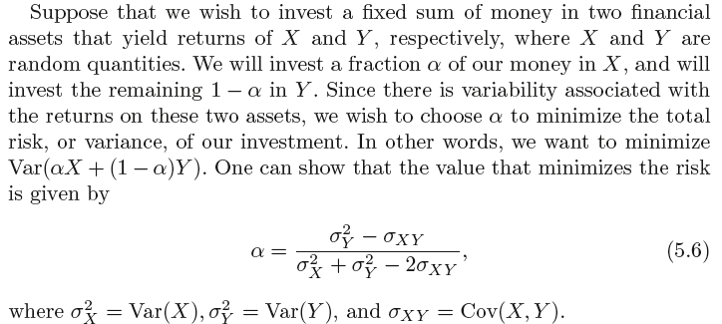
Bootstrap

Slide 11
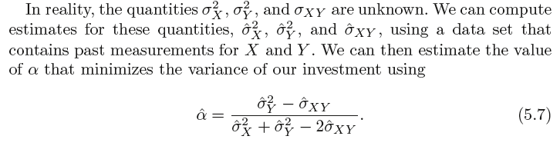
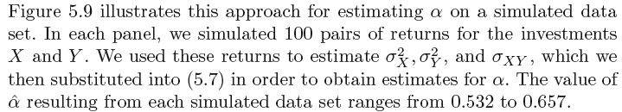
Bootstrap

Slide 12
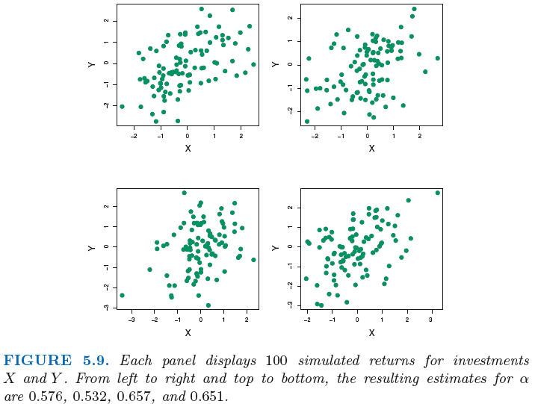
Bootstrap

Slide 13
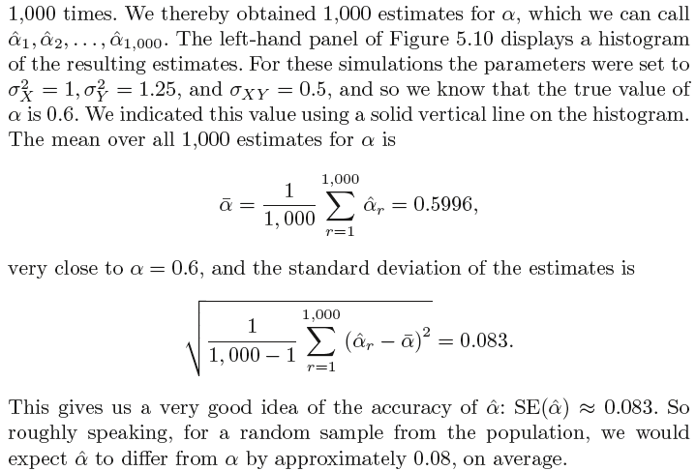
Quantifying the Accuracy of α

Slide 14
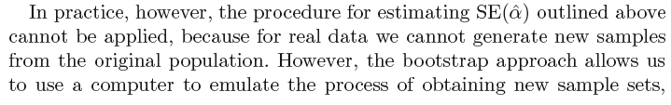
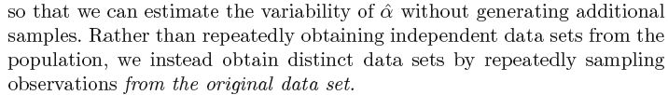
Bootstrap

Slide 15
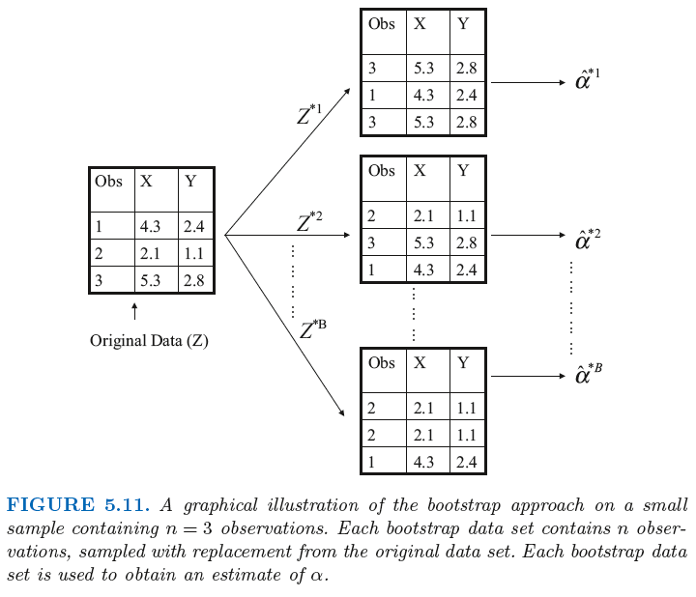
Bootstrap
Randomly select n observations
Sampling with replacement

Slide 16
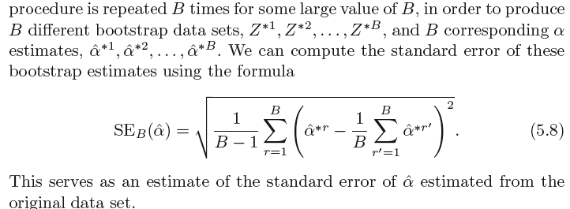
Bootstrap

Slide 17
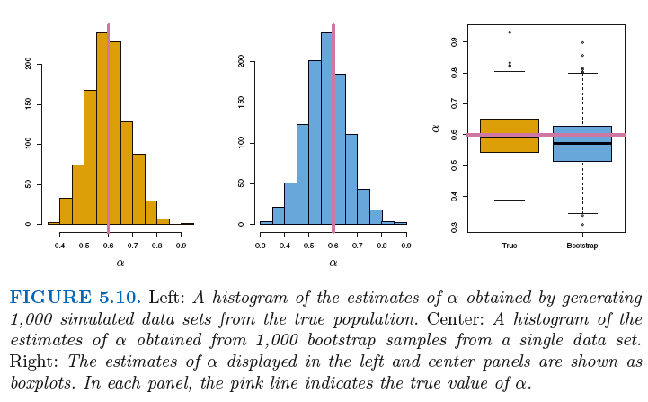
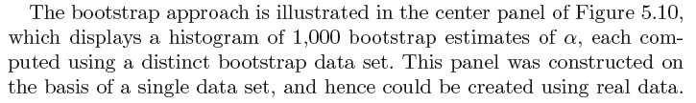
Bootstrap

Slide 18
Bootstrap
Notes:
End of session 1
Source: Am Stat. 2015 Oct 2; 69(4): 371–386
Figure shows a population, the sampling distribution for the mean with n = 50, four samples, and the corresponding bootstrap distributions. Each bootstrap distribution is centered at the statistic x‾ from the corresponding sample rather than at the population mean μ. The spreads and shapes of the bootstrap distributions vary a bit but not a lot.
These observations inform what the bootstrap distributions may be used for. The bootstrap does not provide a better estimate of the population parameter, because the bootstrap means are centered at x‾, not μ. Similarly, quantiles of the bootstrap distributions are not useful for estimating quantiles of the sampling distribution. Instead, the bootstrap distributions are useful for estimating the spread and shape of the sampling distribution.
The right column shows additional bootstrap distributions for the first sample, with r = 1000 or r = 10⁴resamples. Using more resamples reduces random Monte Carlo variation, but does not fundamentally change the bootstrap distribution—it still has the same approximate center, spread, and shape.
The Monte Carlo variation is much smaller than the variation due to different original samples. For many uses, such as quick-and-dirty estimation of standard errors or approximate confidence intervals, r = 1000 resamples is adequate. However, there is noticeable variability (including important but less-noticeable variability in the tails) so when accuracy matters, r = 10⁴ or more samples should be used.

Slide 19
Cross-Validation
Notes:
Begin session 2

Slide 20
Estimating Test Error: Holding Out
Training vs. test error?
How to estimate test error?
We consider a class of methods that estimate the test error rate by holding out a subset of the training observations from the fitting process, and then applying the statistical learning method to those held out observations.

Slide 21
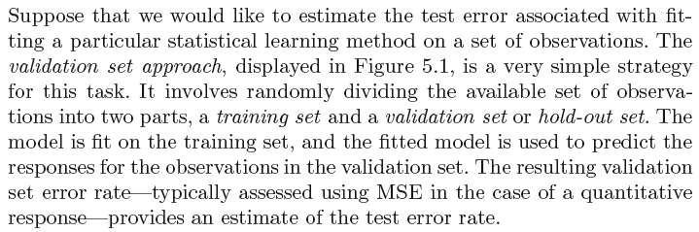
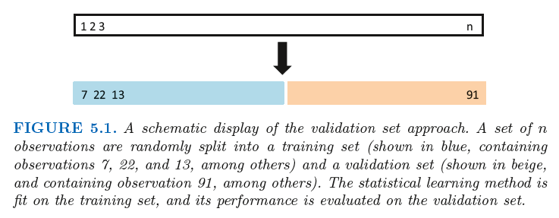
The Validation-Set Approach

Slide 22
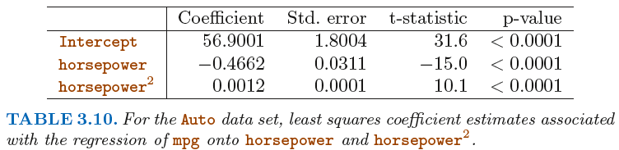
Flashback: Polynomial Regression
Notes:
End second session

Slide 23
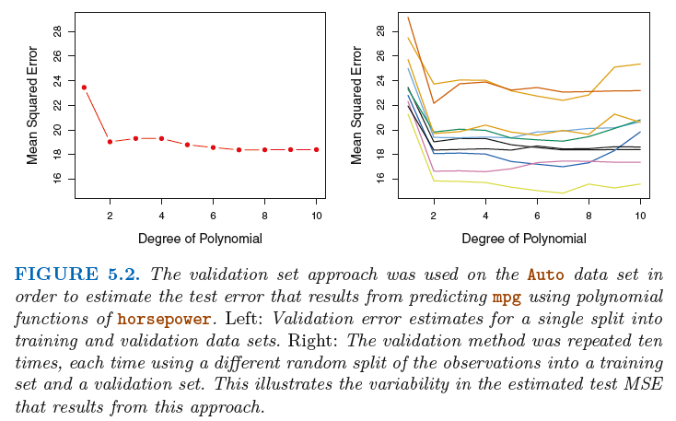
The Validation-Set Approach

Slide 24
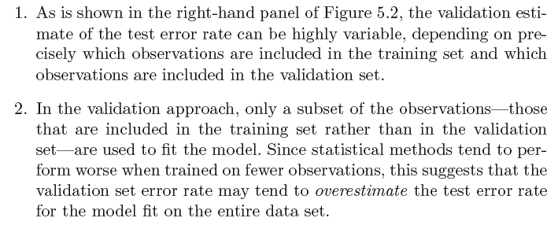
The Validation-Set Approach: Disadvantages

Slide 25
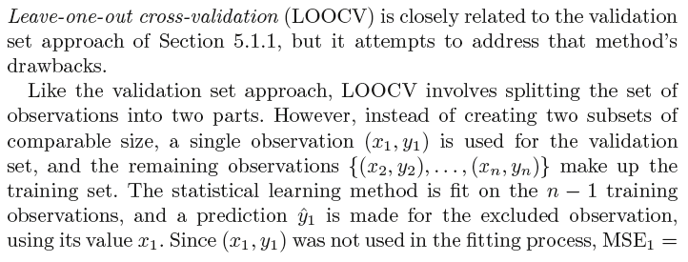
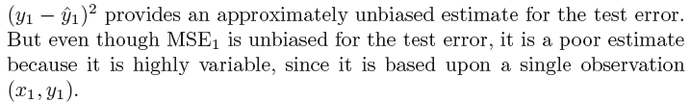
Leave-One-Out Cross-Validation (LOOCV)

Slide 26
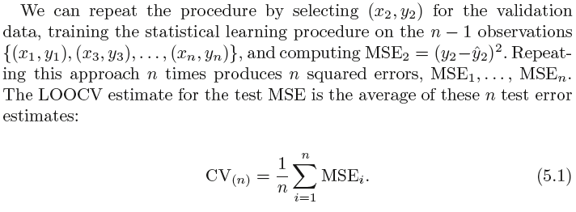
Leave-One-Out Cross-Validation (LOOCV)

Slide 27
LOOCV – Two Major Advantages Over the Validation-Set Approach
First, LOOCV has far less bias.
In LOOCV, we repeatedly fit the statistical learning method using training sets that contain n − 1 observations, almost as many as are in the entire data set.
This is in contrast to the validation set approach, in which the training set is typically around half the size of the original data set.
Consequently, the LOOCV approach tends not to overestimate the test error rate as much as the validation set approach does.

Slide 28
LOOCV – Two Major Advantages Over the Validation-Set Approach
Second, in contrast to the validation approach which will yield different results when applied repeatedly due to randomness in the training/validation set splits, performing LOOCV multiple times will always yield the same results: there is no randomness in the training/validation set splits.

Slide 29
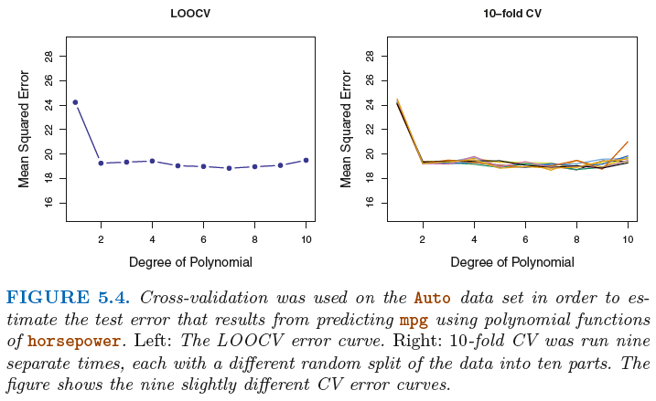
LOOCV
Notes:
End session 2

Slide 30
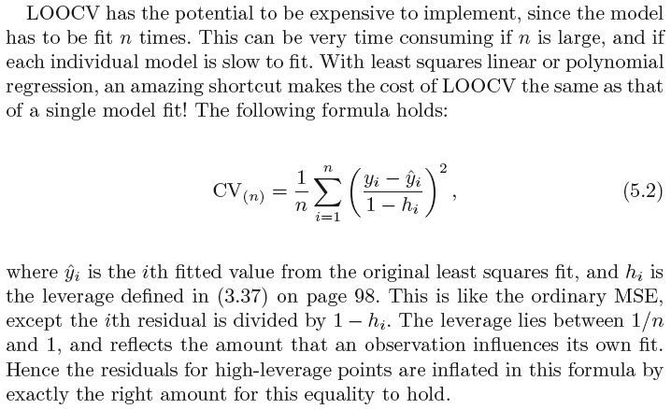
LOOCV – Special Case Shortcut
Does not hold in general!

Slide 31
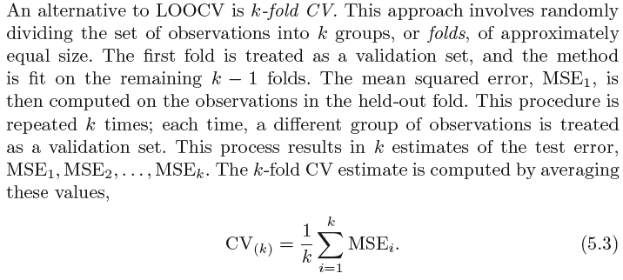
k-fold Cross-Validation
Notes:
Begin session 3

Slide 32
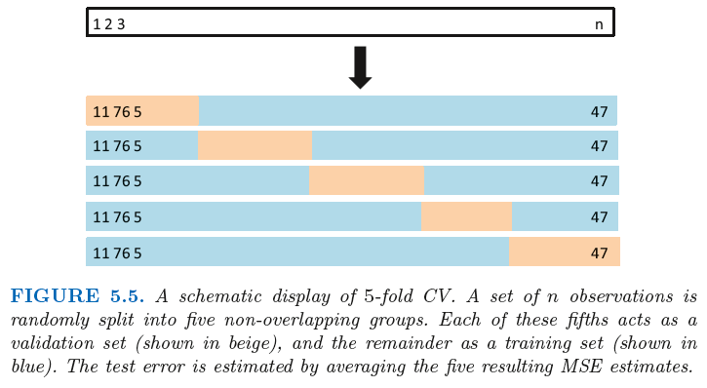
k-fold Cross-Validation

Slide 33
k-fold Cross-Validation

Slide 34
LOOCV: Special Case of k-fold CV
LOOCV is a special case of k -fold CV in which k is set to equal n.
In practice, one typically performs k -fold CV using k = 5 or k = 10.
What is the advantage of using k = 5 or k = 10 rather than k = n?
The most obvious advantage is computational. LOOCV requires fitting the statistical learning method n times.
But cross-validation is a very general approach that can be applied to almost any statistical learning method.
Some statistical learning methods have computationally intensive fitting procedures, and so performing LOOCV may pose computational problems, especially if n is extremely large.
In contrast, performing 10-fold CV requires fitting the learning procedure only ten times, which may be much more feasible.
Also, advantageous as regards the bias-variance tradeoff.

Slide 35
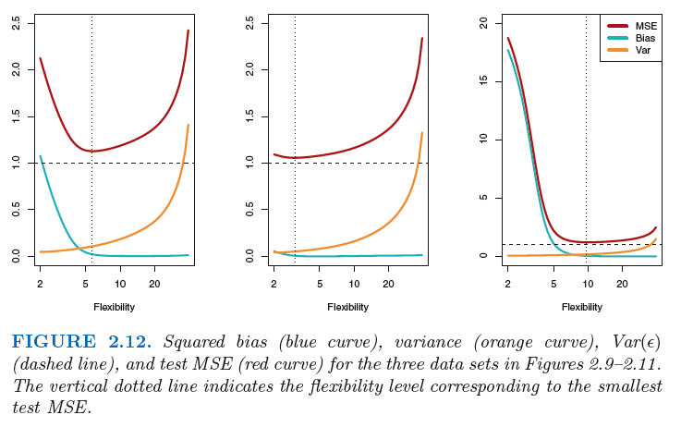
Flashback: Bias-Variance Trade-off
Key question: how to choose the level of flexibility for real data?
Notes:
See slides 26-28 from lecture on 170125 (Lecture #2).

Slide 36
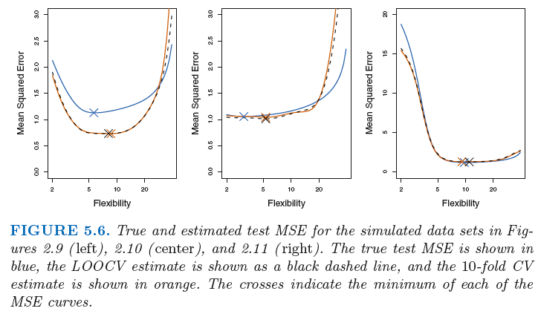
k-fold Cross-Validation

Slide 37
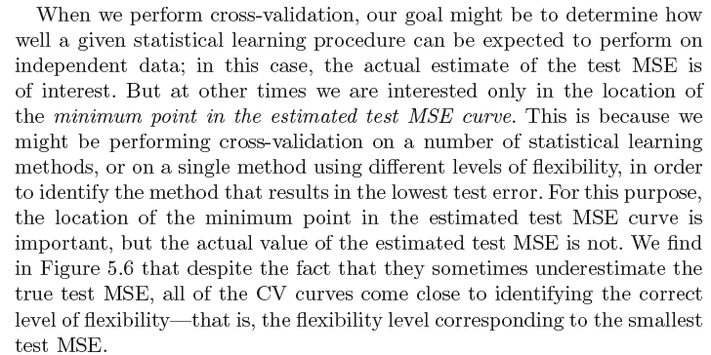
Model Performance and Model Selection

Slide 38
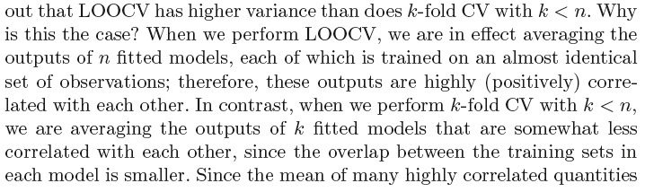
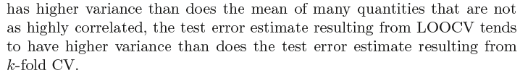
LOOCV vs. k-fold CV: Bias-Variance Tradeoff
Bias: Validation-set vs. LOOCV vs. k-fold CV?
But bias not the only source for concern in an estimating procedure: need to pay respect to variance too!

Slide 39
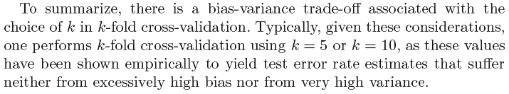
LOOCV vs. k-fold CV: Bias-Variance Tradeoff

Slide 40
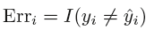
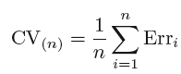
What About CV on Classification Problems?
First things first, what’s the error rate in the classification setting?
Then, LOOCV can be done as:
And, similarly, k-fold CV.

Slide 41
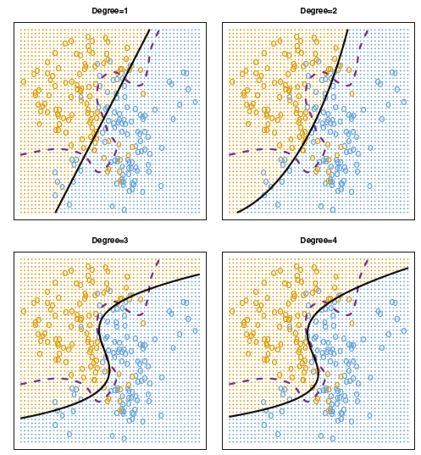
CV on Classification Problems
Notes:
Logistic regression with polynomial functions of the predictors.

Slide 42
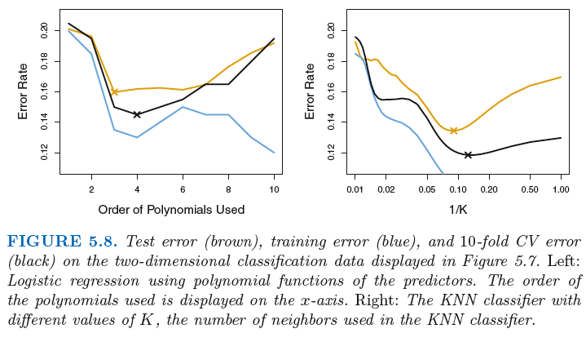
CV on Classification Problems
Notes:
End of session 3

Slide 43
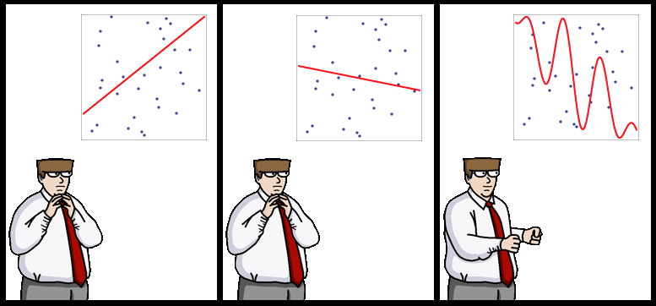
End of Lecture #7
Source: http://yaroslavvb.blogspot.com/

